Slide 1
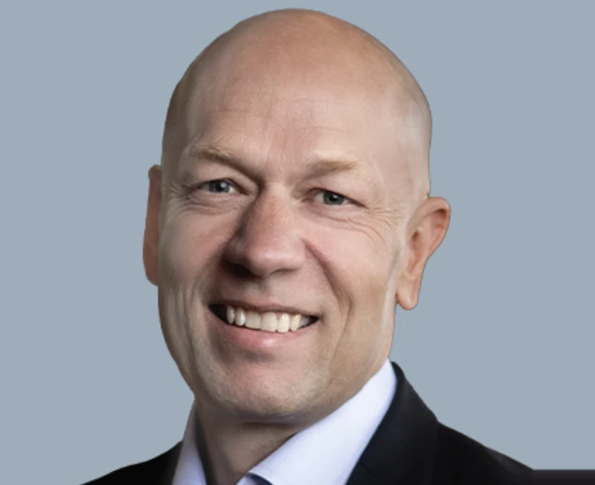
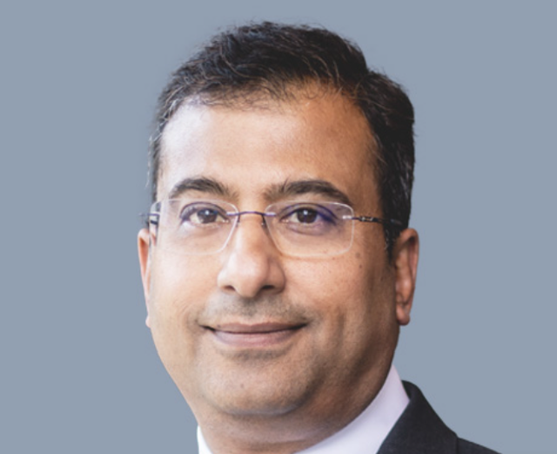
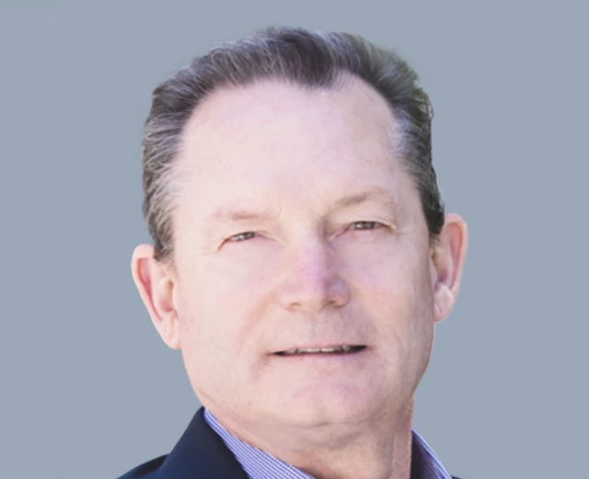
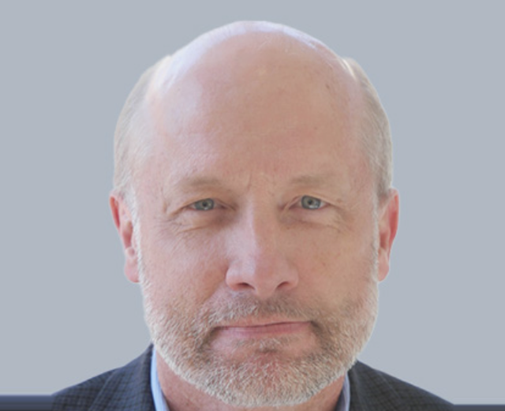
Jacob Thaysen
CEO
Since Sep '23 (3.1 yrs)
<0.03% Ownership
Ankur Dhingra
CFO
Since Apr '24 (2.5 yrs)
<0.01% Ownership
Steve Barnard
CTO
Since Aug '23 (3.2 yrs)
<0.02% Ownership
Kevin Pegels
Chief of Global Ops
Since 2021 (~5 yrs)
<0.01% Ownership
Avg. tenure in role ~3.5 yrs; combined ownership 0.06% of shares outstanding (2026 proxy, as of 3/26/26)

